Slide 1
Hybrid Recommendation System
Prepared By: Lawrencia Archer

Slide 2
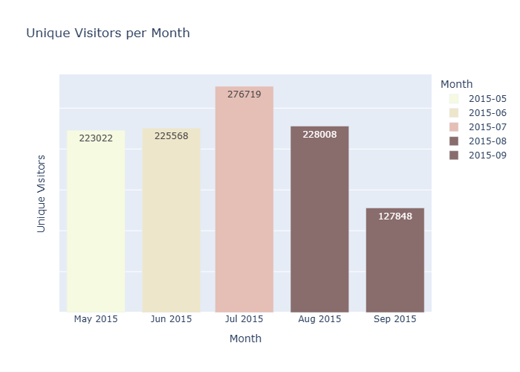
Q1: Unique visitor per month
Conclusion:
The month of July had the most unique visitors, followed by August.
September recorded the least number of unique visitors.

Slide 3
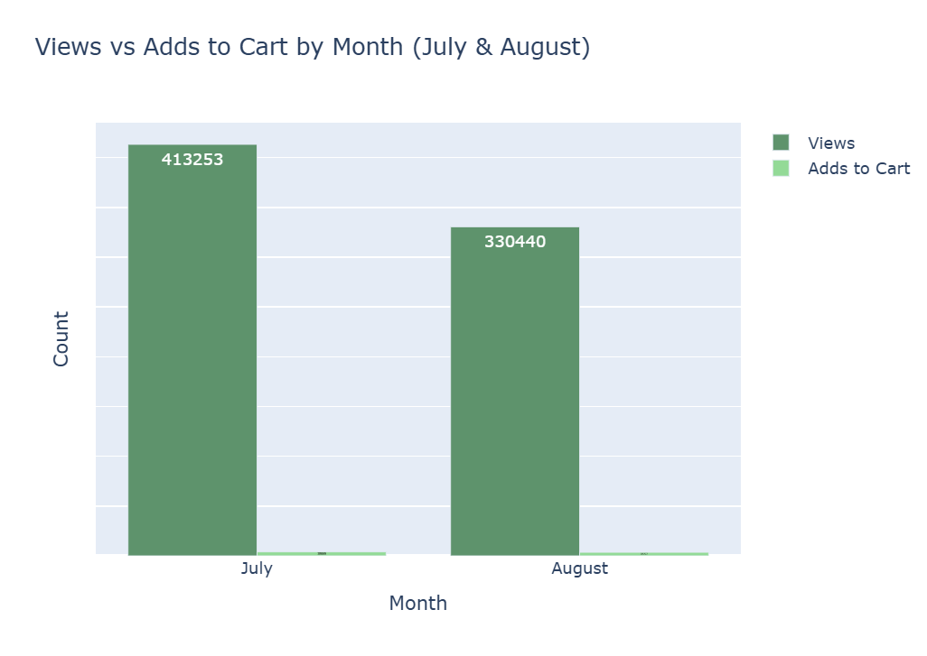
Q2. Visitor item interactions monthly
Conclusion:
Most visitors viewed a lot of items in the month of July.
September recorded the least number of visitor item interactions as compared to July.

Slide 4
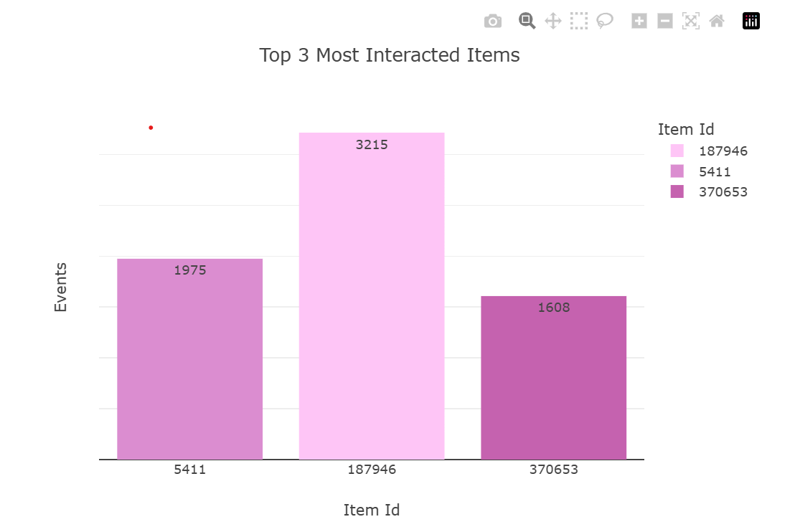
Q3. Top three most interacted items
Conclusion
- Item ID 187946 had the most overall interactions from users.
- Recording 3215 interactions in all from users. ,

Slide 5
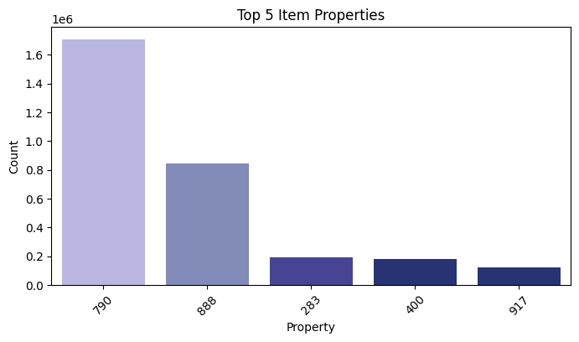
Q4.Top five item property
Conclusion
- Property 790 repeated the most during the specified period.
- It had interactions from visitors followed by property 888.

Slide 6
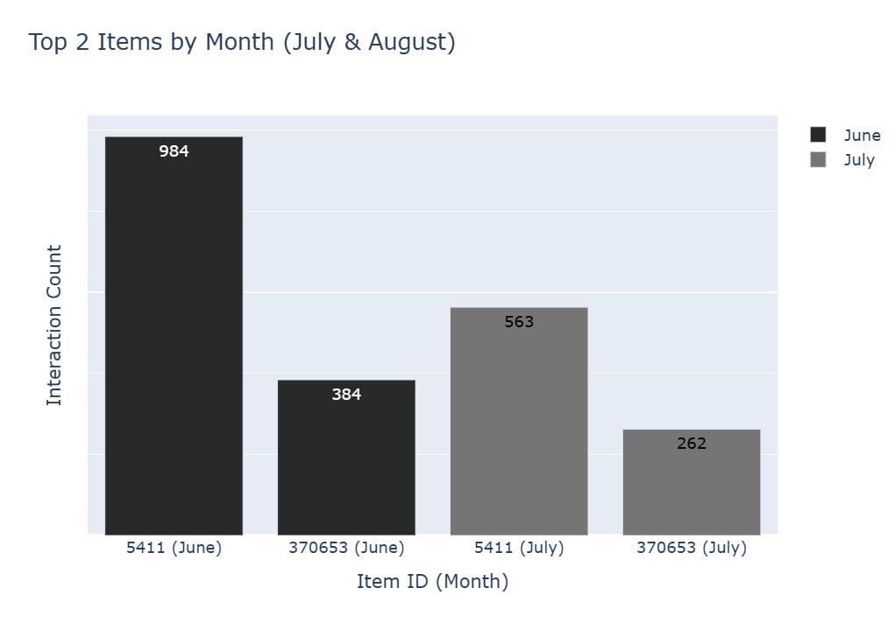
Q5.Top 2 most interacted items in June and July.
Conclusion
Item ID”5411” had the most interactions in June and July.
- Item ID “370653” was second for both months. This shows that most visitors viewed both items.

Slide 7
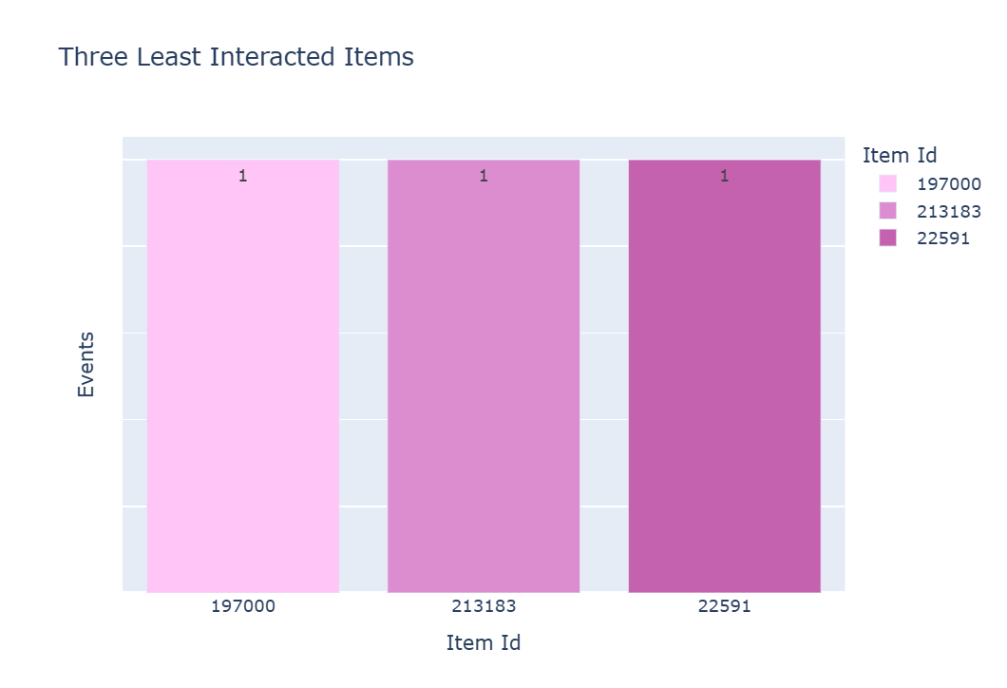
Q6. The least interacted item across visitors
Conclusion
Items with IDs 197000, 213183, and 2259 were the least interacted with over the period.
This shows that it needs more promotion to help make it more visible to visitors.

Slide 8
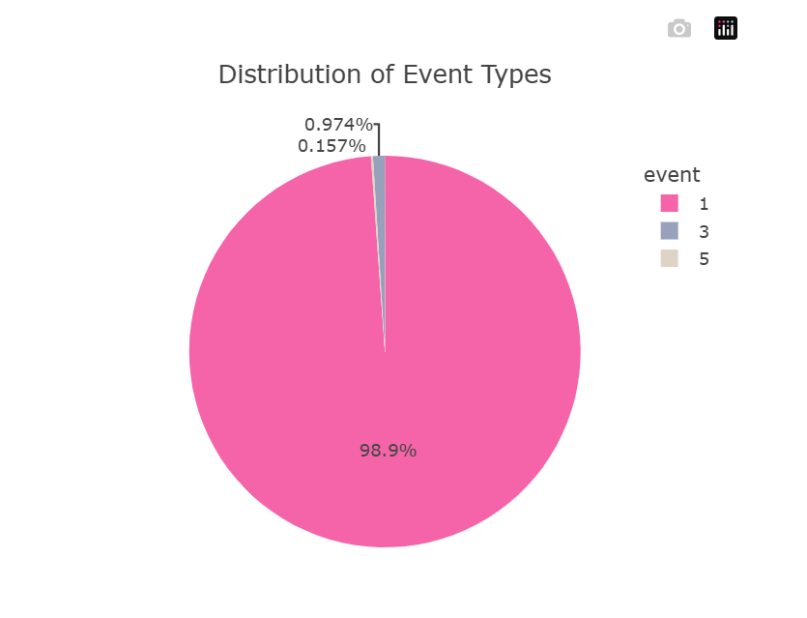
Q7. Total event types.
Conclusion
98.9% of the event logs recorded were visitors viewing items. While 0.97% were added to the cart. And 0.16 purchased the items.

Slide 9
Final insight
Visitor Trends by month:
Visitor engagement peaks in July, both in terms of unique and total interactions.
Property Interactions:
Certain properties and items dominate interactions, highlighting key products or features that attract more visitors
Monitoring low-interaction items could help identify opportunities for promotion and optimization.
Item Interaction:
Seasonal trends are evident, which could inform marketing strategies or inventory management.

Slide 10
Overview of Methods Used
1. Data Loading And Preprocessing.
Tools Used: (Pandas, Numpy)
Steps:
Loaded and read data with Pandas.
Changed data types.
Cleaned missing values and cleared outliers.
Separated values from columns to make a column on its own column.
Created new columns.
2. Data Transformation.
The datasets were merged to achieve a master dataset that was used in the model training and testing.

Slide 11
Overview of Methods Used Cont.
3. Exploratory Data Analysis and Visualization.
Tools Used: (Plotly, Matplotlib, and seaborn)
Visualization Created:
Bar chats comparing item IDs and visitor IDs
Event interaction distribution.
Visitor-item interactions
4. Model training, testing, and validation. Deploying
Tools used: (Tensorflow, Keras, Sklearn, and Streamlit)
The dataset was split into 2. 80% for training and 20% for testing
Neural networks were used in the model training and testing.
Metrics such as recall, regression, and precision were used to evaluate the model.
Link to GitHub: https://github.com/llawlaw23/Recommendation-System

